Slide 1
Mapping Cardinalities
Sachin Vardhan CSE(AIML) 2201331530231

Slide 2
Table of contents
01
02
03
04
One to One
One to Many
Many to One
Many to Many

Slide 3

01
One to One

Slide 4
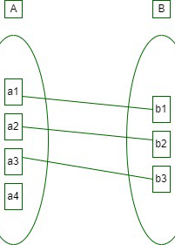

One to One
A single instance in entity A can relate to only one instance in entity B, and vice versa.
Example: A country has only one capital city, and a capital city belongs to only one country.

Slide 5
02
One to Many

Slide 6
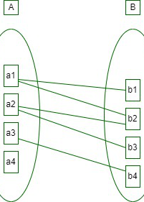
One to Many
A single instance in entity A can relate to multiple instances in entity B. However, an instance in entity B can only relate to one instance in entity A.
Example: A customer (entity A) can place many orders (entity B), but each order belongs to only one customer.

Slide 7
03
Many to One

Slide 8
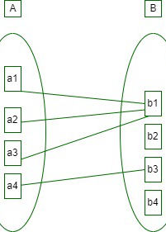
Many to One
The inverse of One-to-Many. Multiple instances in entity A can relate to a single instance in entity B.
Example: Many employees (entity A) can work in a single department (entity B).

Slide 9
04
Many to Many

Slide 10
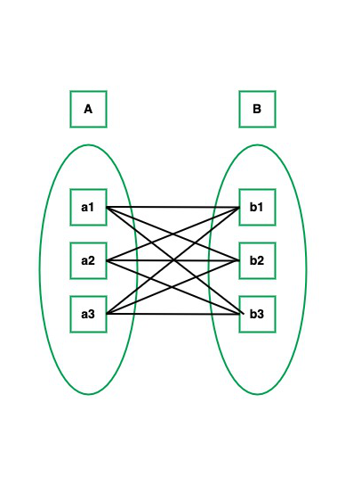
Many to Many
Multiple instances in entity A can relate to multiple instances in entity B, and vice versa.
Example: Students (entity A) can enroll in many courses (entity B), and each course can have many students.

Slide 11
Thank You

